Slide 1
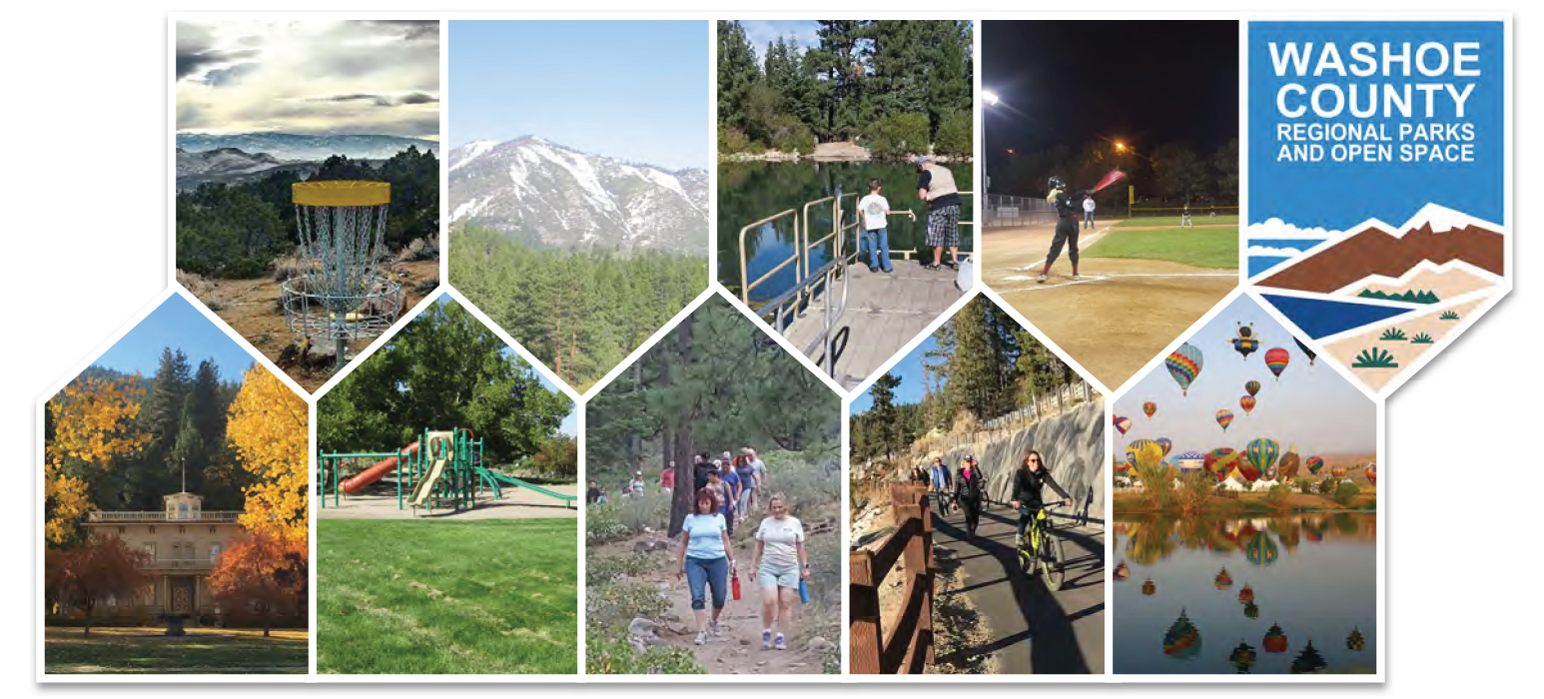
2019 Parks Master Plan

Slide 2
Commissioner Comments
Formatting (legible text, table of contents, page numbers, etc.)
Recognition and inclusion of all entities that collaborate with Washoe County Regional Parks and Open Space
Specific comments related to the planning areas
Ideas about what to include in the executive summary

Slide 3
Executive Summary – Pages 1 & 2

Slide 4
Executive Summary – Page 3

Slide 5
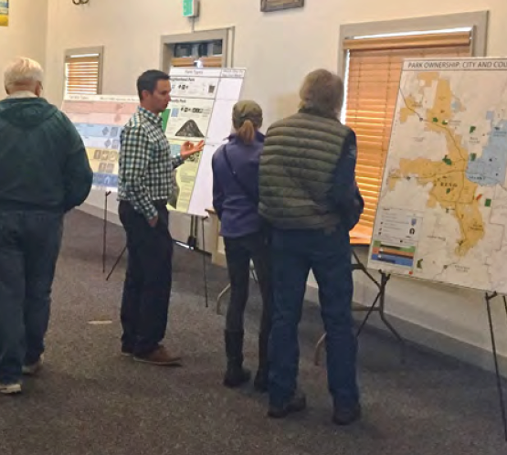
Executive Summary – Page 4
Residents Want:
Regional Parks
Build Out Existing Park Master Plans
Open Space Acquisition
Residents Use:
Hiking Trails
Natural Areas/Open Space
Multi-Use Paths

Slide 6
Executive Summary – Page 5
Planning Area Opportunities:
Build Out Regional Parks (Lazy 5, North Valleys, South Valleys, etc.)
Utilize Reclaimed Water
Acquire Open Space
Provide Trail Connections
Update Existing Park Facilities

Slide 7
Executive Summary – Page 6
Short-Term, Mid-Term and Long-Term Strategies

